Slide 1

COST OF LIVING ANALYSIS
By: Cheila, Kassem, Amar, Lionel and Safo

Slide 2
Contents Page
Introduction
Data Source
Extract, Transform and Load
Cost of Living Database
Visualisation Process
Most Expensive Places to Live
Cheapest Places to Live
Rent Index
Analysis Summary
Conclusion

Slide 3

Why Cost of Living?
Introduction
Cost of living is the amount of money required to cover basic expenses, such as; housing, food, taxes, and healthcare in a certain region in a given time period.
Current world situations have been affecting our everyday lives.
It is important to understand the differences in the cost of living across the world.

Slide 4
Project Scope
Create a webpage dashboard that allows you to be able to look at 4 levels of data related to heat maps analysing the costs of living data.
Create 4 visuals looking at the most and least expensive places to live.
Produce a visual looking at rent for our selected locations.

Slide 5

Data Obtained
We considered the use of 3 different data sets (CSV files), covering the data from the year of 2020, 2021 and 2022.
These indices are relative to New York City (NYC).
Which means that for New York City, each index should be 100(%). If another city has, for example, rent index of 120, it means that on an average in that city, rents are 20% more expensive than in New York City.
If a city has rent index of 70, that means on average rent in that city is 30% less expensive than in New York City.

Slide 6
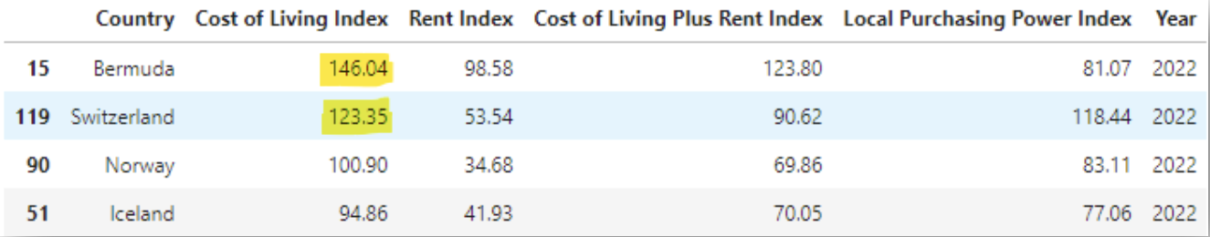
Data Source
Cost of Living Index databases:
2020 (https://www.kaggle.com/datasets/andradaolteanu/2020-cost-of-living)
2021 (https://www.kaggle.com/datasets/ryanbbrown/cost-of-living-index-by-country-numbeo-2021)
2022 (https://www.kaggle.com/datasets/ankanhore545/cost-of-living-index-2022)
Database brings the information relative to New York
Cost of Living index in Bermuda is 46% higher than in NYC.
Switerland is 23% more expensive than NYC.

Slide 7
Indices Used
Country: Country name for a given cost of living information.
Cost of Living Index: a relative indicator of consumer goods prices, including groceries, restaurants, transportation and utilities.
Rent Index: estimation of prices of renting apartments in the city compared to New York City.
Cost of Living Plus Rent Index: estimation of consumer goods prices including rent comparing to New York City.
Local Purchasing Power Index: shows relative purchasing power in buying goods and services in a given city for the average net salary in that city.

Slide 8
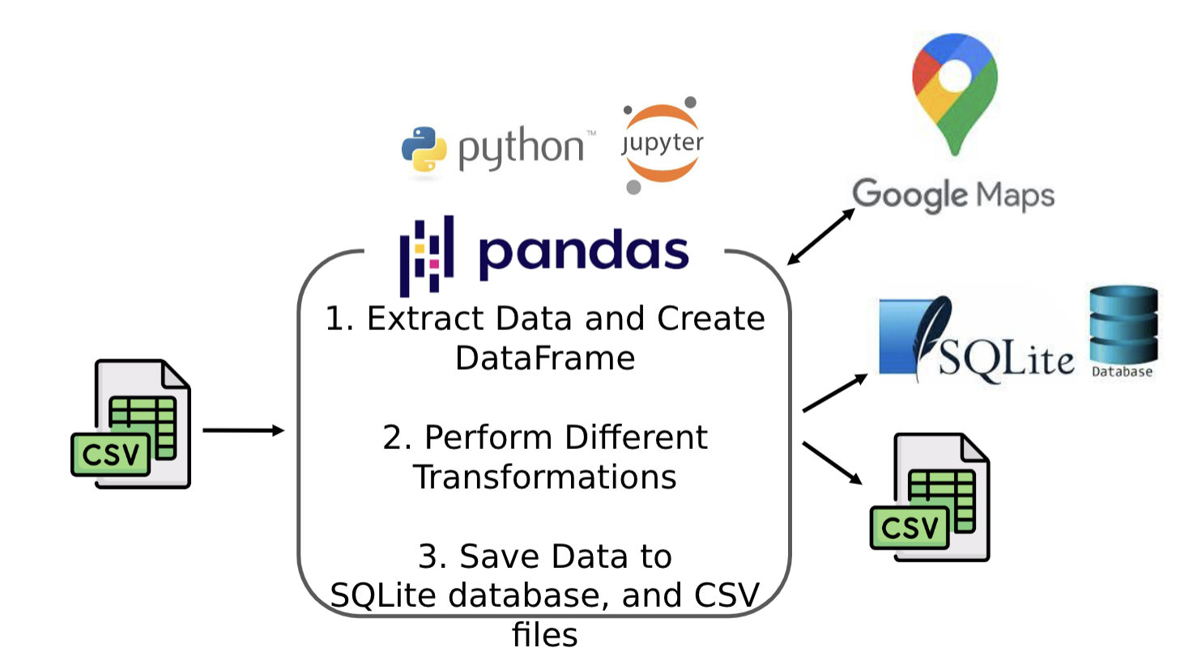
Extract – Transform - Load
Data Extracted from CSV files.
Unnecessary columns removed.
Additional information added.
Lat + Long information populated using GoogleMaps API.
Cleaned data loaded to SQLite database.

Slide 9
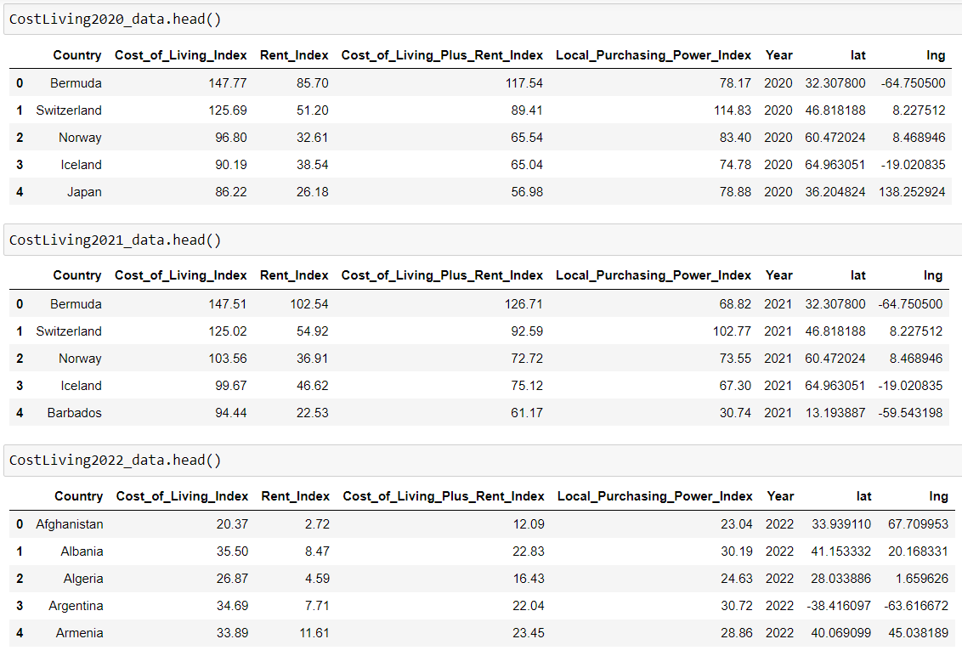
Cost of Living Database

Slide 10
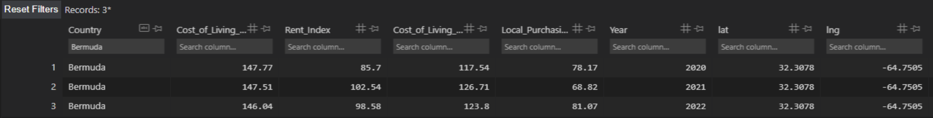
Cost of Living Database
Cost of Living Index databases (2020, 2021, 2022) were transformed and loaded into one table in SQLite Database

Slide 11
VISUALISATION PROCESS
Front End
HTML Pages
SQL Database & app.py
Java Script

Slide 12
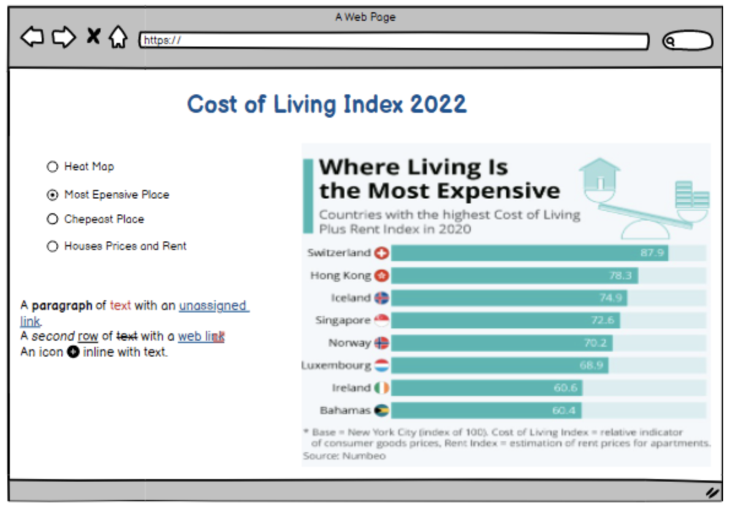
DEMO FRONT END

Slide 13
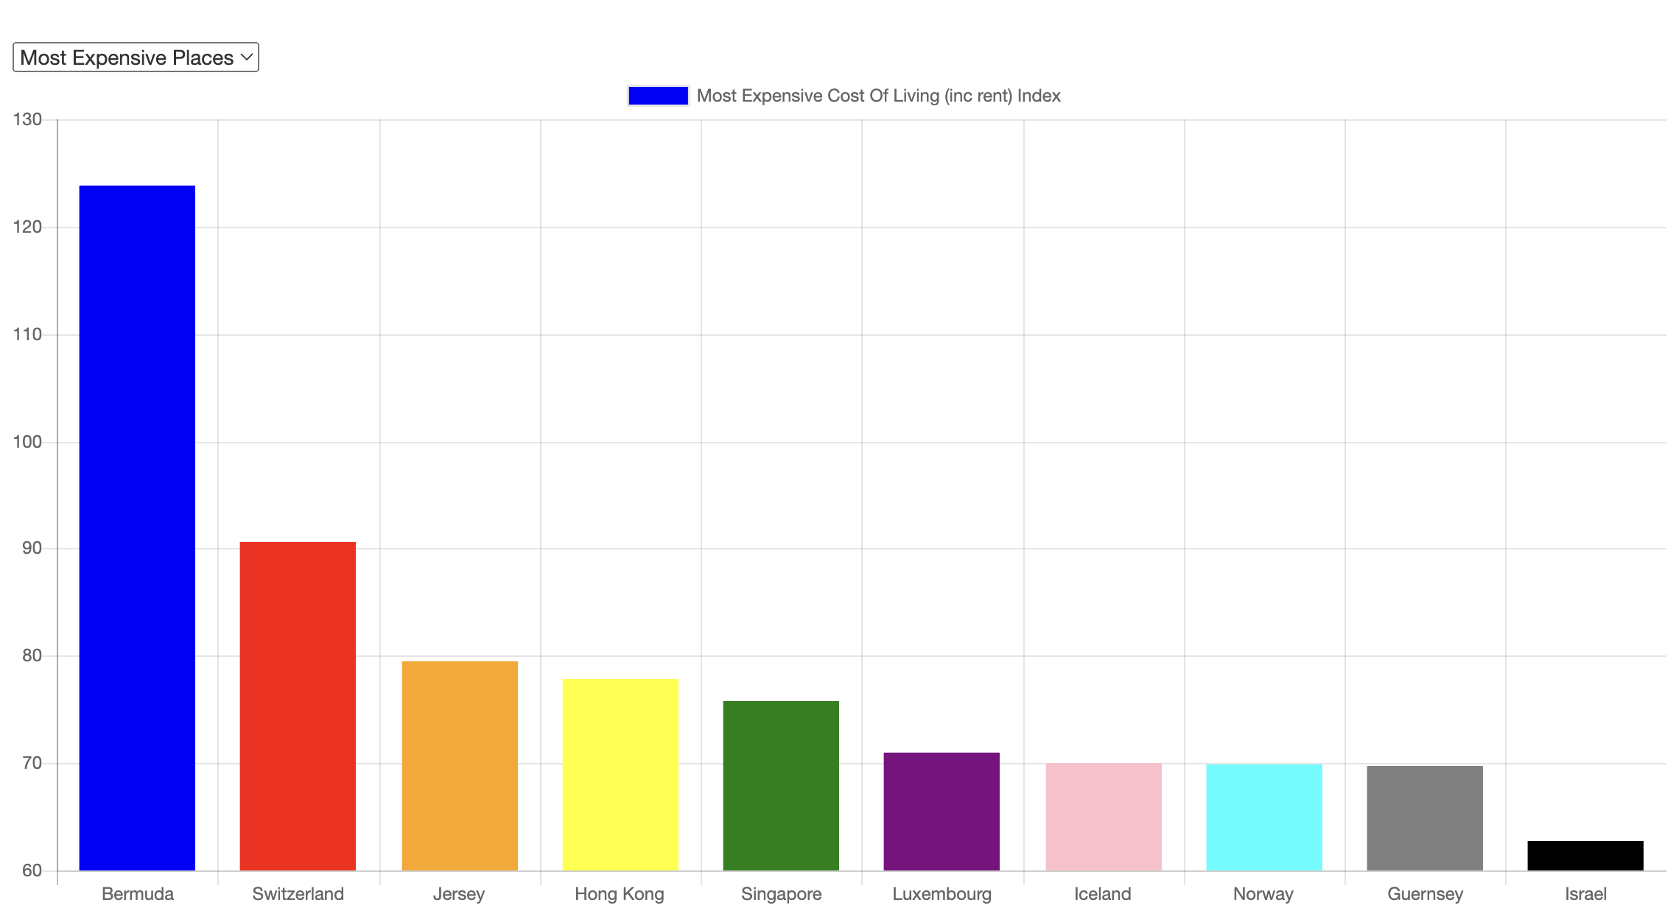
Most Expensive Places

Slide 14
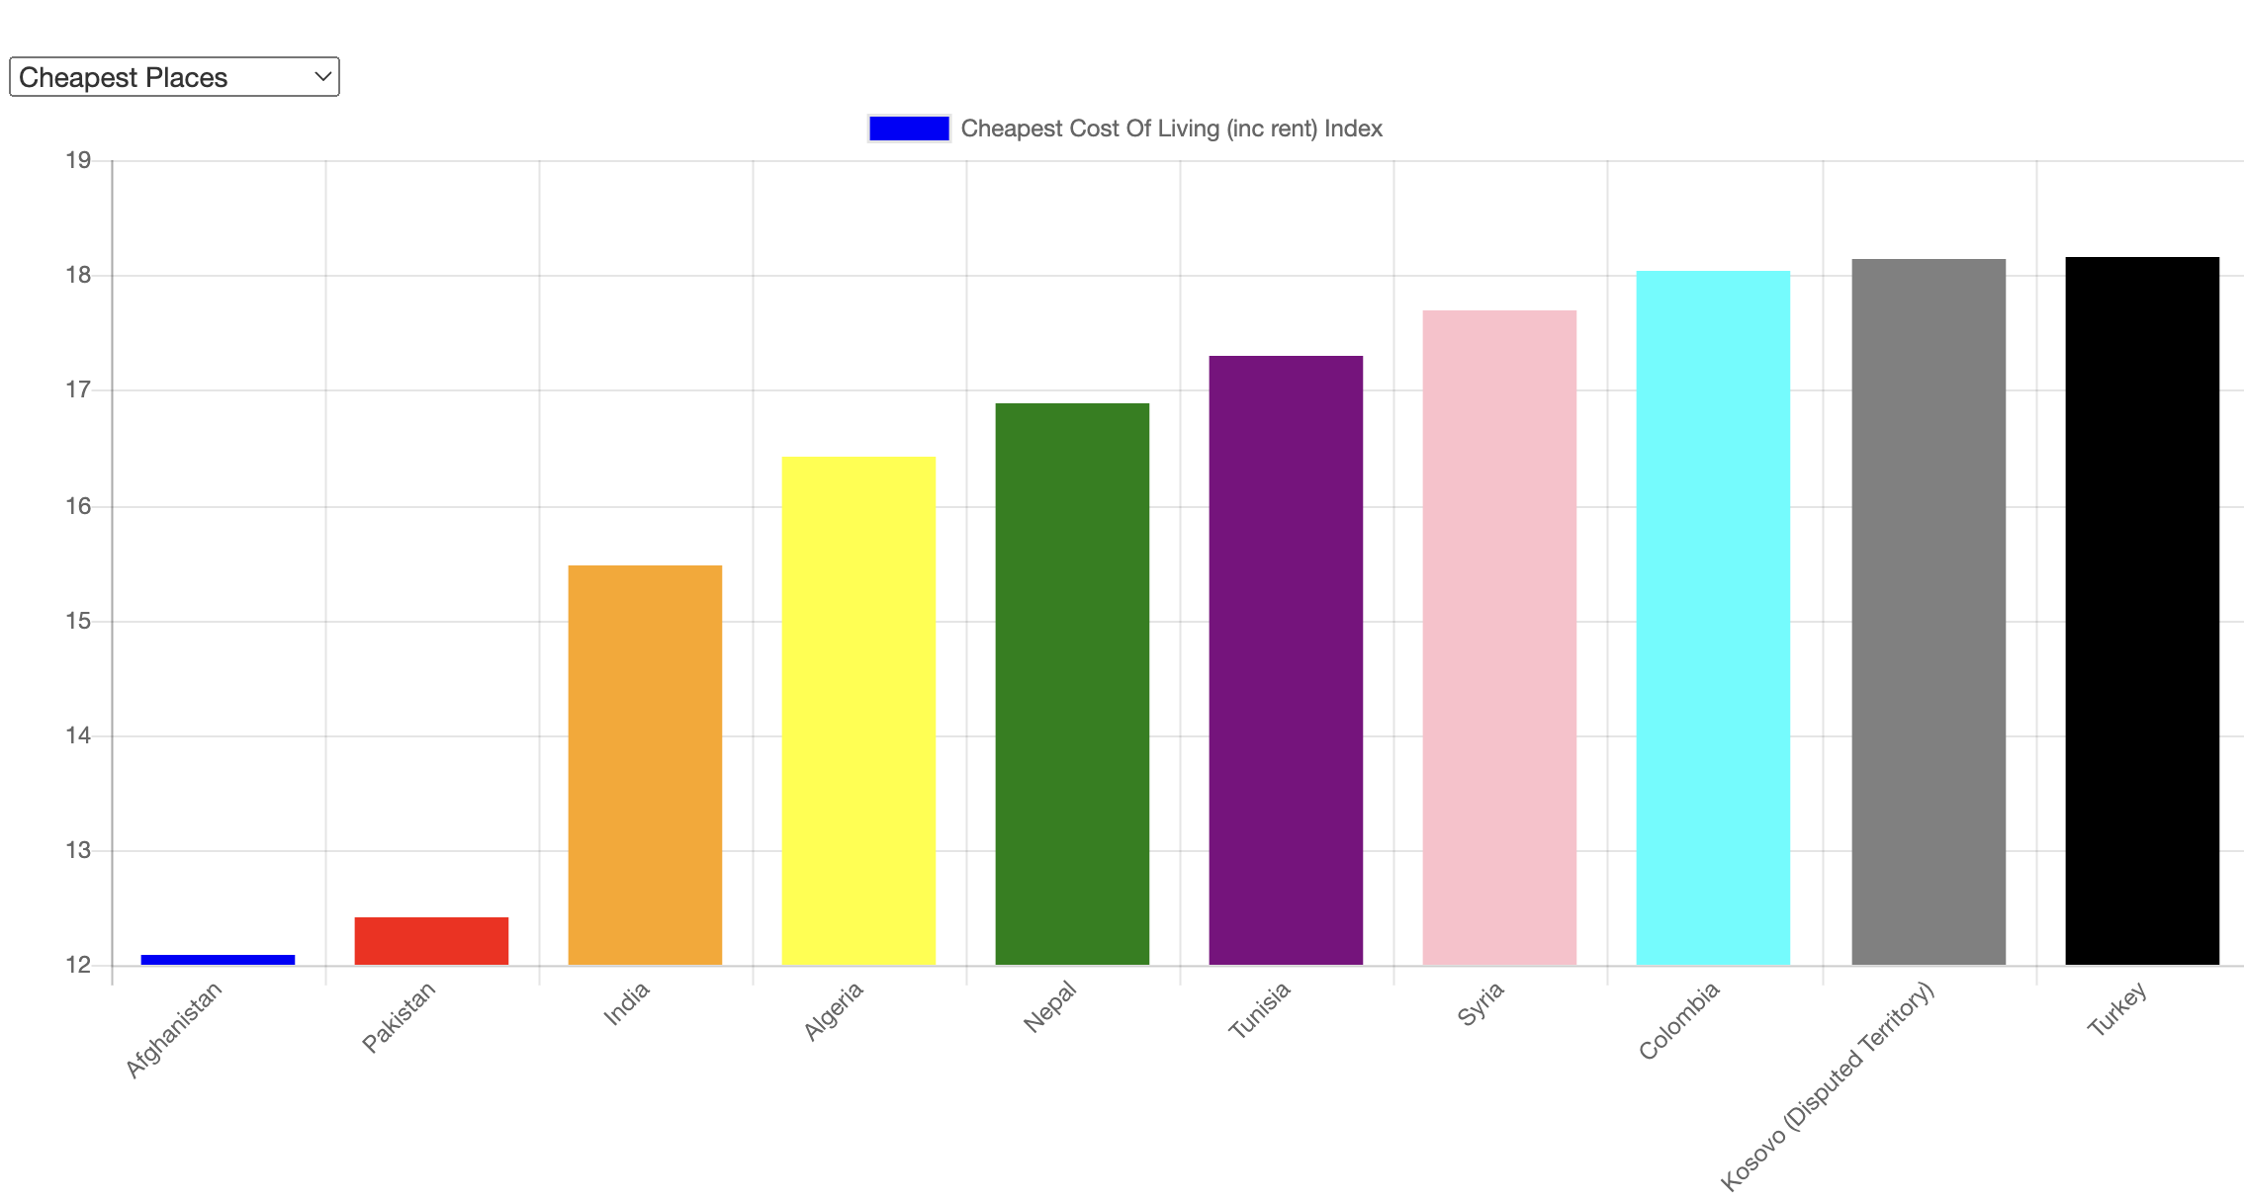
Cheapest Places

Slide 15
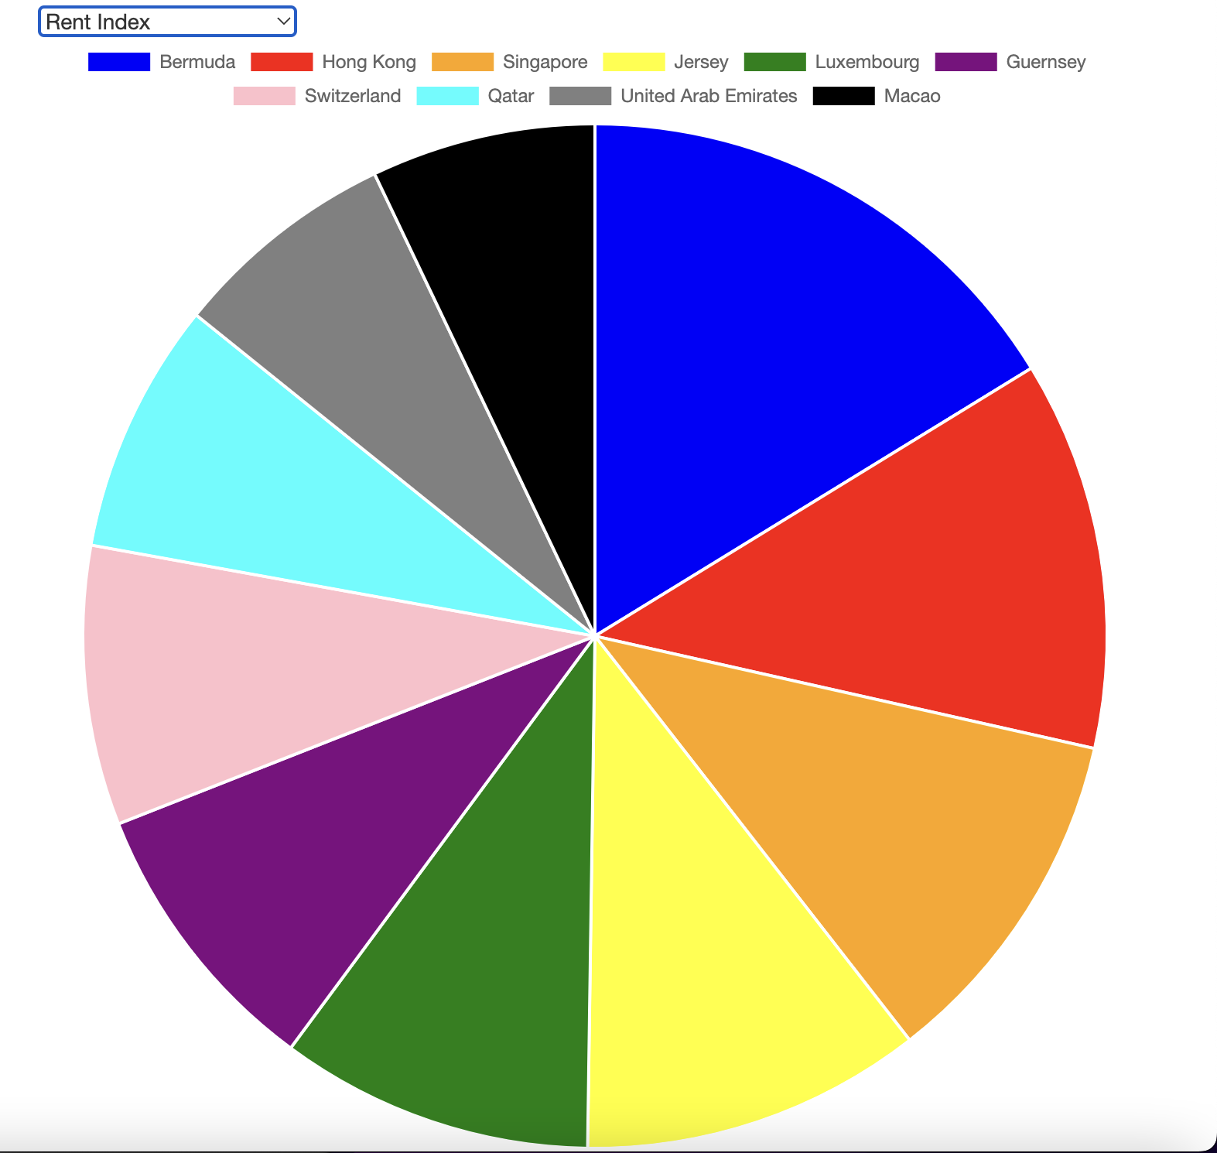
Rent Index

Slide 16
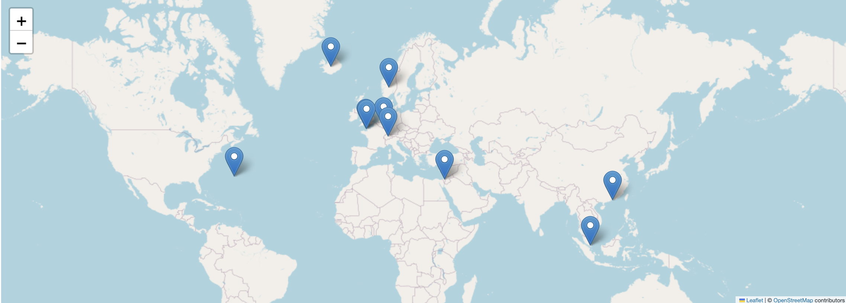
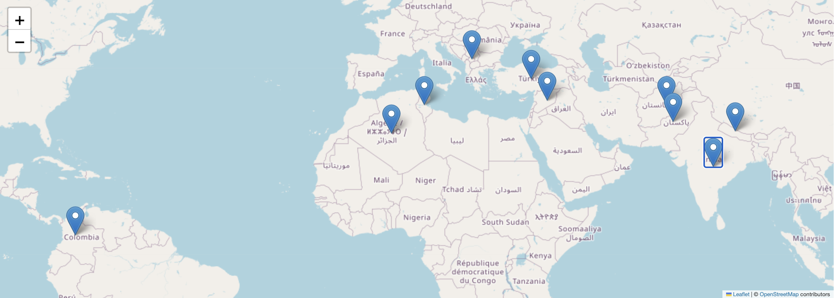
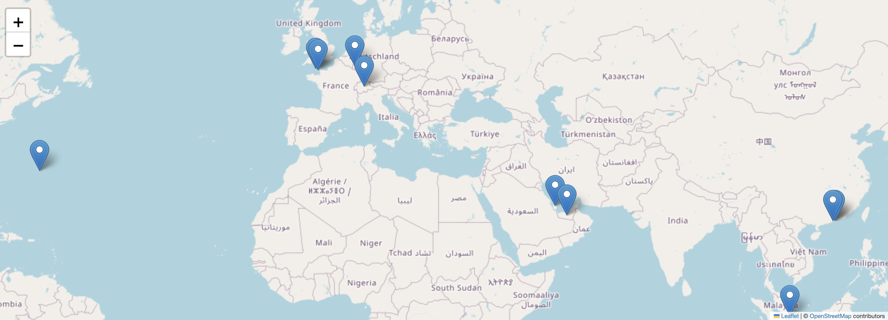
Heatmaps
Most Expensive Places
Cheapest Places
Rent Index

Slide 17
Analysis Summary
The most expensive place to live including rent index is Bermuda (123.8), followed by Switzerland (90.62) and Jersey (79.51).
The cheapest place to live including rent index is Afghanistan (12.9), followed by Pakistan (12.42) and India (15.47).
The country with the highest rent index is Bermuda (98.58), followed by Hong Kong (74.57) and Singapore (66.43).

Slide 18
Conclusion
New York is the bench mark for cost of living because most of the studies carried out have been obtained by American based researchers.
Bermuda, Switzerland and Norway over the past 2 years have always been among the first 5 countries with the higher cost of living.
South Asia predominantly have a lower cost of living as shown by Afghanistan, Pakistan and India being the cheapest.
The dashboard has multiple user-driven interactions (such as by using dropdowns menu, a hover function to show intrinsic data) which is included all on a single webpage dashboard.
The final page displays visualizations in a clear, digestible manner and is clearly displayed with no to many data labels to focus on and the data story is easy to interpret for users of all levels.

Slide 19
Limitations
People working full time which meant setting up meetings outside of the course hours was difficult.
Limited time – Deciding which database was the best to use (MongoDB or SQLite).
Lack of knowledge – Front End visualisations was originally on one page.

Slide 20
References
Cost of Living Index databases:
2020 (https://www.kaggle.com/datasets/andradaolteanu/2020-cost-of-living)
2021 (https://www.kaggle.com/datasets/ryanbbrown/cost-of-living-index-by-country-numbeo-2021)
2022 (https://www.kaggle.com/datasets/ankanhore545/cost-of-living-index-2022)

